Slide 1
GROUP
Definition
According to Stephen. R. Robbins, “Group consists of two or more individuals, interacting and interdependent, who have come together to achieve particular objectives”.

Slide 2
Characteristics of Group
Strong desire of association
Cohesiveness
Leadership quality
Awareness of members
Individual properties

Slide 3
STAGES OF GROUP DEVELOPMENT
FORMING
STORMING
NORMING
PERFORMING

Slide 4
Types of Group
Group
Formal Group
Command group
Task group
Project group
Committees
Informal Group
Friendship group
Interest group
Reference group
Membership

Slide 5
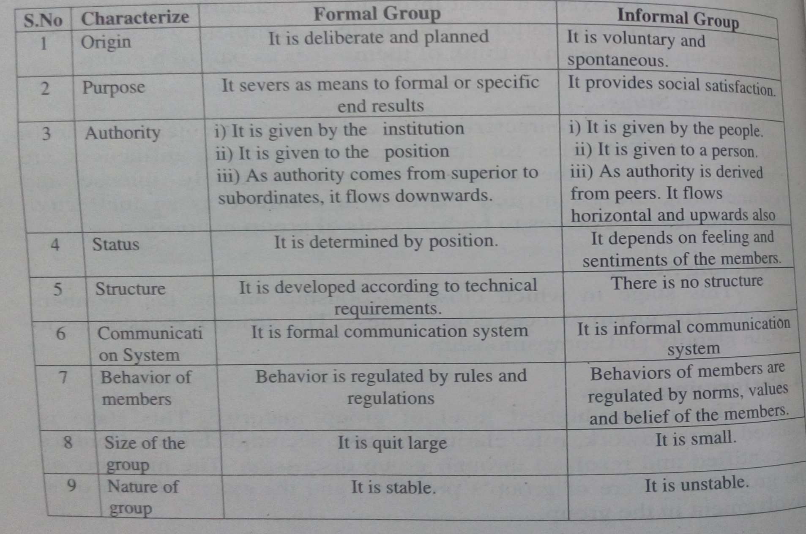
Difference between formal and informal group

Slide 6
GROUP DYNAMICS
Definition :
According to Kurt Lewin, “Group dynamics deals with internal nature of groups, how they are formed, what structure and processes they adopt, how they function and affect individual members, other groups and the organization”

Slide 7
PRINCIPLES OF GROUP DYNAMICS
The members of the group should have a strong belongingness.
The more attractive a group is to its members, the greater the influence it would exercise on its members.
The greater the prestige of a group member in the eyes of other members, the greater the influence he will exercise.

Slide 8
PRINCIPLES OF GROUP DYNAMICS
Successful efforts to change individuals would result in making them conform to the norms of the group.
Strong pressure for change in group can be established by creating a shared perception about the need for change.
All the members must share the consequences of change.
Strain created by changes can be reduced by bringing readjustments.

Slide 9
COMPONENTS OF GROUP DYNAMICS
Group norms
Group role
Group status
Group size
Group leadership
Group composition
Group cohesiveness

Slide 10
GROUP COHESIVENESS
Meaning:
Cohesiveness is a degree to which group members are attracted to each other and are motivated to stay in the same group.

Slide 11
CHARACTERISTICS OF GROUP COHESIVENESS
Members share group goals and norms & have common interests and backgrounds.
No of members – small
Members interact frequently and communicate effectively
Members stand united against all threats
Members feel that their need would be satisfied by the group
Group should have history of past success

Slide 12
FACTORS DETERMINING GROUP COHESIVENESS
Status of the group
Size of the group
Inter dependency
Time spent together
Leadership style
External threats
Autonomy
Communication
Management behaviour
Location of the group
Previous successes
Nature of the group

Slide 13
GROUP NORMS
Meaning:
A group norm is a rule that tells the individual how to behave in a particular group.

Slide 14
CHARACTERISTICS OF GROUP NORMS
Norms apply only to behaviour and not to private thoughts and feelings.
The norms are the basis for predicting and controlling the behaviour of good members.
Norms are identifying the values and ethics of the group members.
Not all norms apply to everyone in the group.

Slide 15
FACTORS AFFECTING CONFORMITY TO GROUP NORMS
Conformity means adjusting one’s behaviour to align with the norms of the group.
  More stable and cohesive.
  When group goals mesh with individual goals.
  Differences in two sets of goals.
  Situational factors like external threats.
  Personality characteristics of individuals.

Slide 16
ENFORCEMENT OF GROUP NORMS
Reasons for giving importance to enforce norms
  Group member’s behaviour
  Level of education
  Group’s survival
  Avoid interpersonal problems

Slide 17
HAWTHORNE EXPERIMENTS
Hawthorne Experiment was conducted for more than 5 years at Hawthorne plant of the Western Electric Company.
Elton Mayo and the staff of Harvard Business School carried out the experiments.
These experiments changed the viewpoints of managers about towards workers.

Slide 18
INITIAL ASSUMPTIONS
Each worker is considered as an isolated independent unit.
It was possible to measure and influence the actions and performance of each worker.
A worker’s output depended on the physical environment.
Low output was due to ill timings, unnecessary physical motions, lack of proper incentives.

Slide 19
SEQUENCE OF EXPERIMENTS
Illumination experiments
Relay assembly test room
Interview programme
Bank wiring group observations

Slide 20
1.Illumination Experiments
Impact of illumination on productivity was tested.
Two separate groups of employees were chosen.
One group was asked to work under steady light, other group under inconsistent light.
Two groups did not have major variations in productivity.

Slide 21
2. Relay room experiments
Six women employees were chosen.
Physical factors like hours of work, rest intervals, temperature, incentives were modified to observe the changes.
Researches found that there is no effective relationship between any of the physical factor and productivity.

Slide 22
3. Interview programme
20,000 interviews were carried out by researches.
A questionnaire was given to employees and responses were received.
Workers explained their problems and what social factor is important according to them.
.

Slide 23
4. Bank wiring group observations
The objective of bank wiring group observation was to examine how a group influences a worker to restrict his output.
Group had 14 workers :
  9 – wireman
  3 – solder man
  2 – inspectors
Output of wiremen determined output of solder man and it determined output of inspectors.
Group had its own social structure, communication patterns and behaviour but it does not influence performance of an individual worker in any ways..

Slide 24
Findings of Hawthorne experiment
Level of production is determined by social norms and not by physiological capacities.
Non-economic rewards and sanctions affect the behavior of workers and restrict the effect of economic incentives.
Workers act as members of group and not as individuals.
Informal leaders play an important role in setting group norms
Importance of communication between ranks

Slide 25
Hawthorne experiments - Criticism
Unscientific enquiry
Restricted scope
Lacking in universal applicability
Over emphasis on worker satisfaction
Undue importance to social norms

Slide 26
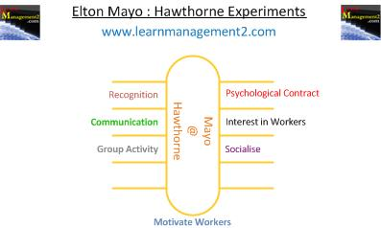

Slide 27
ORGANISATIONAL CONFLCIT
Meaning:
Conflict is a natural disagreement resulting from individuals or groups who differ in attitudes, beliefs, values or needs.

Slide 28
TYPES AND SOURCES OF ORGANISATIONAL CONFLICT
Intra – personal conflict.
Inter – personal conflict.
Inter – group conflict.
Inter – organization conflict.

Slide 29
INTRA PERSONAL CONFLICT
1) Goal conflict
  Approach-approach conflict
  Approach-avoidance conflict
  Avoidance-avoidance conflict
2) Role conflict
  Person-role conflict
  Inter-role conflict
  Intra-sender role conflict
  Inter-sender conflict

Slide 30
2. INTER – PERSONAL CONFLICT
Personality differences
Perceptions
Clash of values and interests
Power & status differences
Scarcity of resources

Slide 31
3. INTER-GROUP CONFLICT
Incompatible goals
Task interdependence
Resources sharing
Joint decision – making
Organizational ambiguities
Introduction of changes

Slide 32
4. INTER ORGANIZATIONAL CONFLICT
Conflict among Organizations with similar goals.
Conflict among government organizations and agencies.
Conflict among corporate office and production units.

Slide 33
METHOD OF HANDLING CONFLICT
1) Preventing conflict
  Super ordinate goals
  Reducing interdependence
  Exchange of personnel
  Appeals to higher authority
2) Resolving conflict
  Problem solving
  Smoothing
  Compromise
  Avoidance

Slide 34
SOCIOMETRY
Meaning
Sociometry is a technique to analyze small groups in order to establish the patterns of interactions among their members.
Designed by J.L.Moreno

Slide 35
WHAT IS SOCIOMETRY
Sociometry enables us to measure, map and build relationships in order to be explored.
It is an essential tool for people to build mature group networks and positive relationship behaviors.

Slide 36
OBJECTIVES OF SOCIOMETRY
To explore intra-group relationship
To move organization from isolated business units to collaborative groups
To strengthen teams
To sort out issues of group conflict, trust and identity
To understand and address unspoken aspects of everyday group life
To develop appropriate behavior for your ideal work culture
To integrate thinking, feeling and action in business relationship
To release informal leadership abilities

Slide 37
SUPERVISION
Definition :
According to Viteles, “Supervision refers to the direct and immediate guidance and control of the subordinates in the performance of their tasks”.

Slide 38
QUALITIES OF A SUPERVISOR
Ability to secure cooperation
Ability to instruct and inspire
Ability to delegate
Ability to judge people
Ability for orderly thinking
Patience
Emotional stability
Ability to Communicate
Knowledge about the organization

Slide 39
FUNCTIONS/REPONSIBILITIS OF A SUPERVISOR
COMMUNICATION OF ORDERS, INSTRUCTIONS
Essentials of an order
When, Whom, Where, How, What, Why
INTRODUCTION OF WORK METHOD
Improvement of existing method
Introduction of the new machines and method
MAKING THE WORK LESS TEDIOUS
Resistance to changes
SELECTION OF EMPLOYEES

Slide 40
INDUCTION OR ORIENTATION OF NEW EMPLOYEES
Basic Information – briefed to employees
Information - received from employees
TRAINING EMPLOYEES
HANDLING GRIEVANCES
ENFORCING DISCIPLINE
ENSURING EFFECTIVE COMMUNICATION
ENFORCING SAFETY

